Slide 1
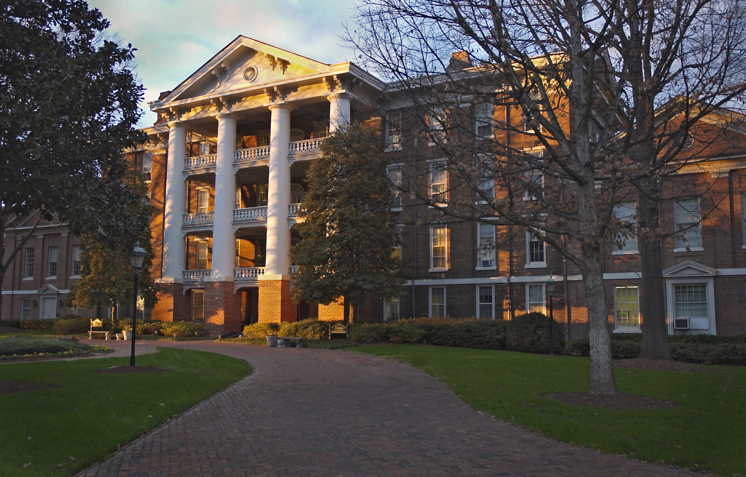
Out of State Families Session
Welcome to Raleigh, NC!

Slide 2

Banking Information
ATM on campus: Fifth Third Bank

Slide 3


Area Hotels
These Hotels Offer discounts to WPU friends and family
Hampton Inn (Downtown)
600 Glenwood Avenue, Raleigh, NC 27603 • Phone: (919) 825-4770
https://secure3.hilton.com/en_US/hp/reservation/book.htm?execution=e1s1
- Two blocks from William Peace University!
- Rates: 10% off traditional rate
- Reservations include a complimentary hot breakfast

Slide 4

Area Hotels
These Hotels Offer discounts to WPU friends and family
Holiday Inn (Downtown)
320 Hillsborough Street, Raleigh, NC 27603 • Phone: (919) 832-0501
https://www.ihg.com/holidayinn/hotels/us/en/raleigh/rdusc/hoteldetail?cm_mmc=GoogleMaps-_-HI-_-US-_-RDUSC
-upon making reservation, share WPU parent and family for discount

Slide 5

Area Hotels
These Hotels Offer discounts to WPU friends and family
DoubleTree Raleigh Crabtree Valley
4100 Glenwood Avenue, Raleigh NC 27612 • 919-782-8600
William Peace University rate: $99 for Standard King
or Double Queen Room
Visit http://raleighcrabtreevalley.doubletreebyhilton.com/
or call and use Corporate ID #2831252

Slide 6
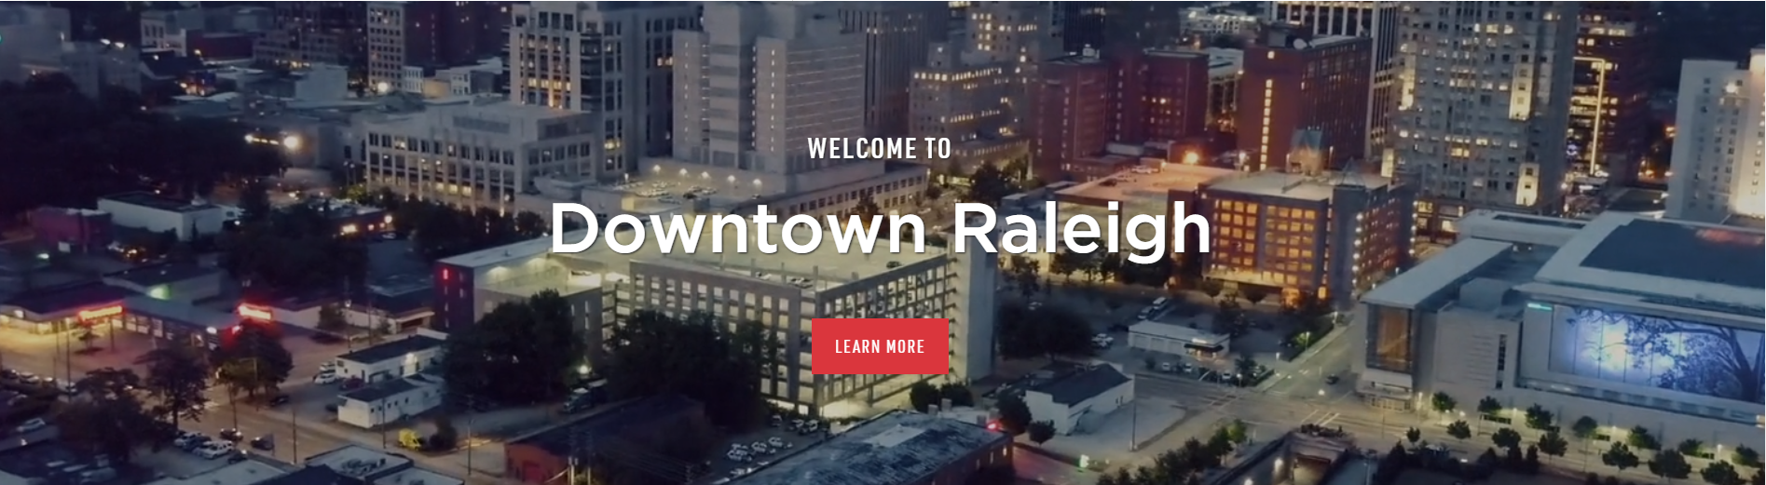
https://www.downtownraleigh.org/

Slide 7
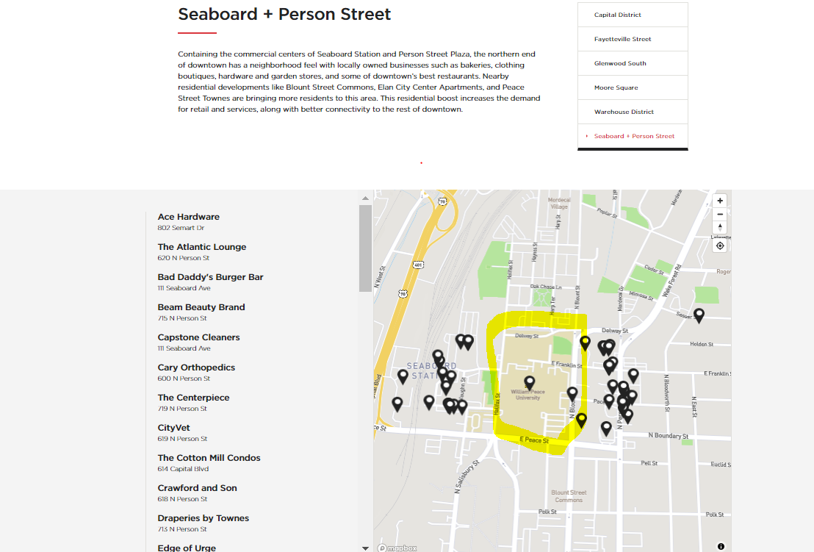
https://www.downtownraleigh.org/

Slide 8
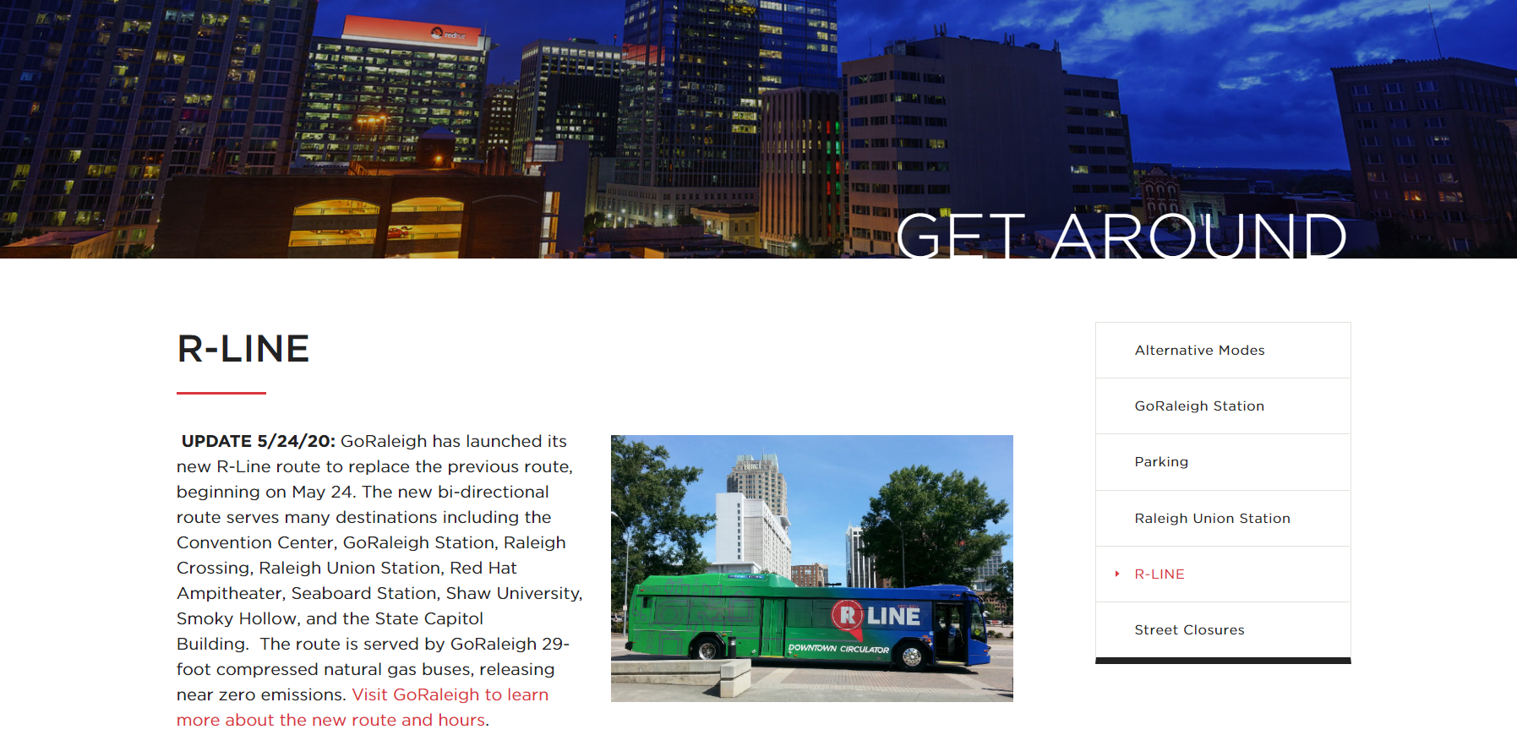
https://www.downtownraleigh.org/

Slide 9

https://www.downtownraleigh.org/
Raleigh's Union Station Video
Opened in 2018
https://www.amtrak.com/stations/rgh

Slide 10
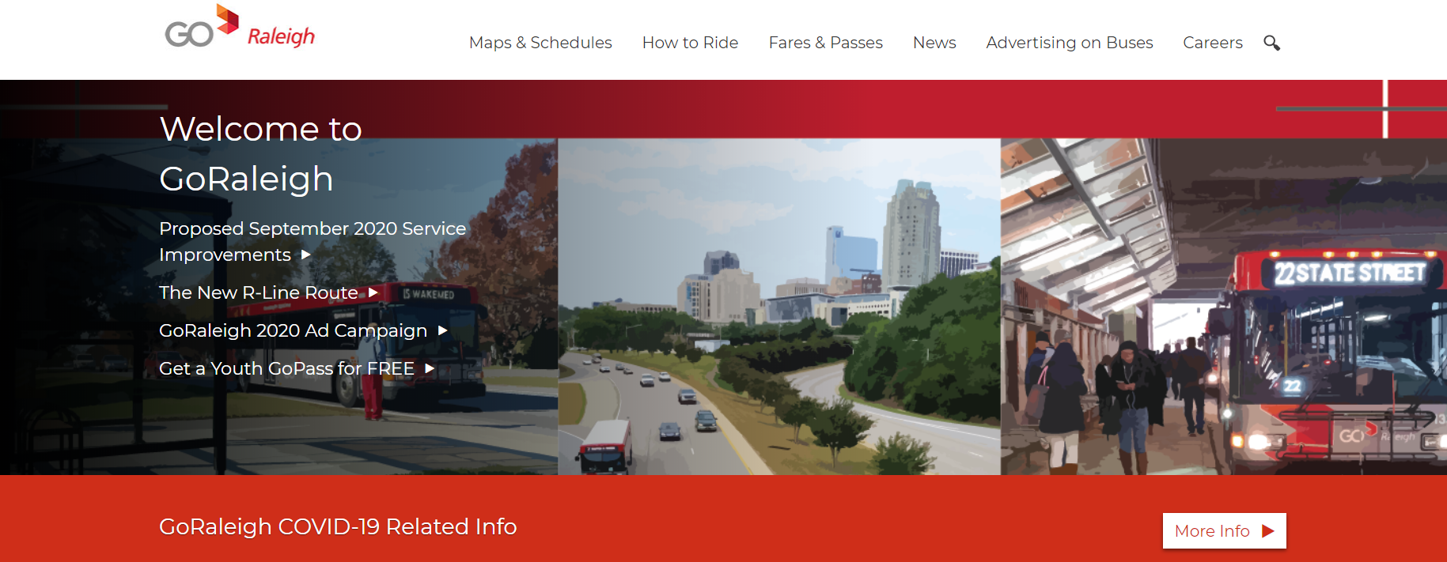
https://goraleigh.org/

Slide 11

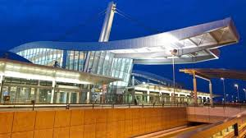
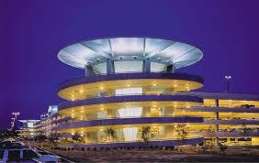
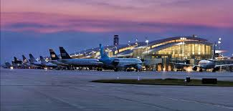

https://www.rdu.com/

Slide 12
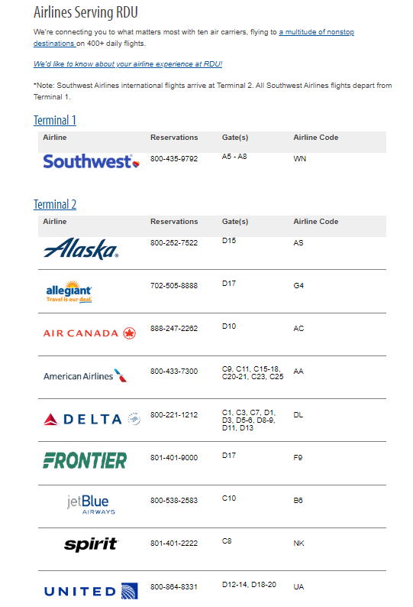
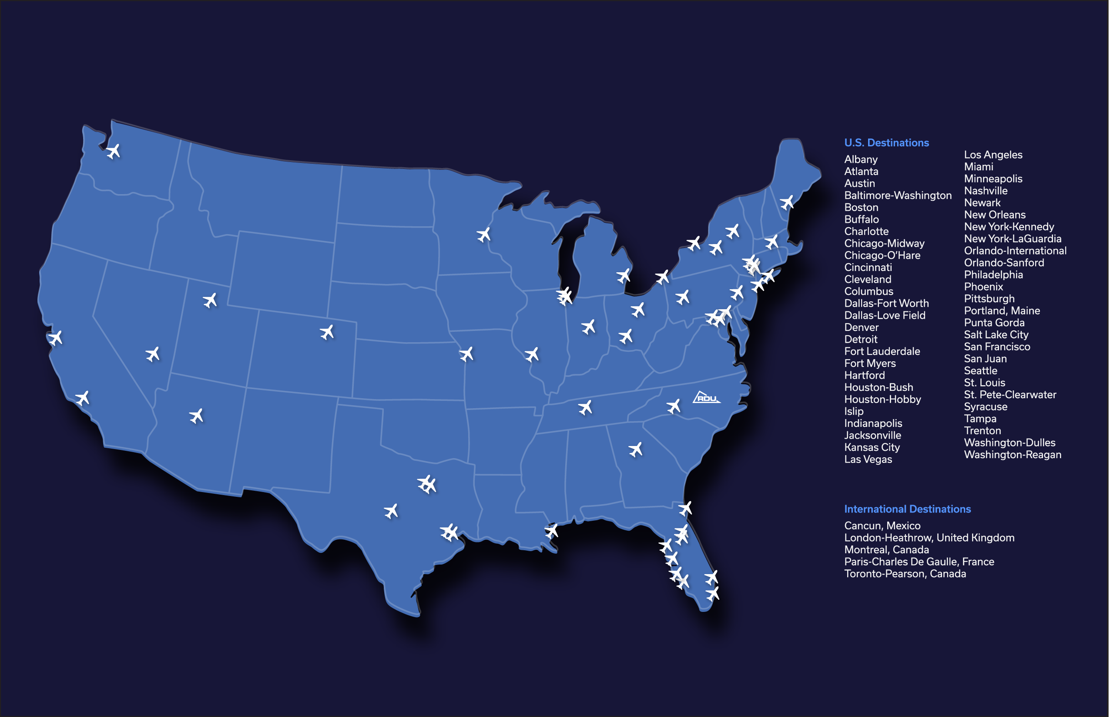

Slide 13


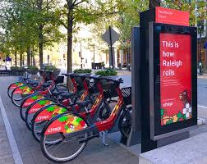
Ride Share Services
Both Uber and Lyft provide services in the Raleigh area.
Downtown Raleigh has several bike share opportunities as well.

Slide 14
Check Out These For More Info
https://raleighnc.gov/history-raleigh
https://www.visitraleigh.com/
https://www.visitraleigh.com/things-to-do/history/

Slide 15
Have Questions?
Dawn Dillon, Director of First Year Experience and Retention
  ddillon@peace.edu
  css@peace.edu
Frank Rizzo, Vice President for Student Life
  frizzo@peace.edu

Slide 16
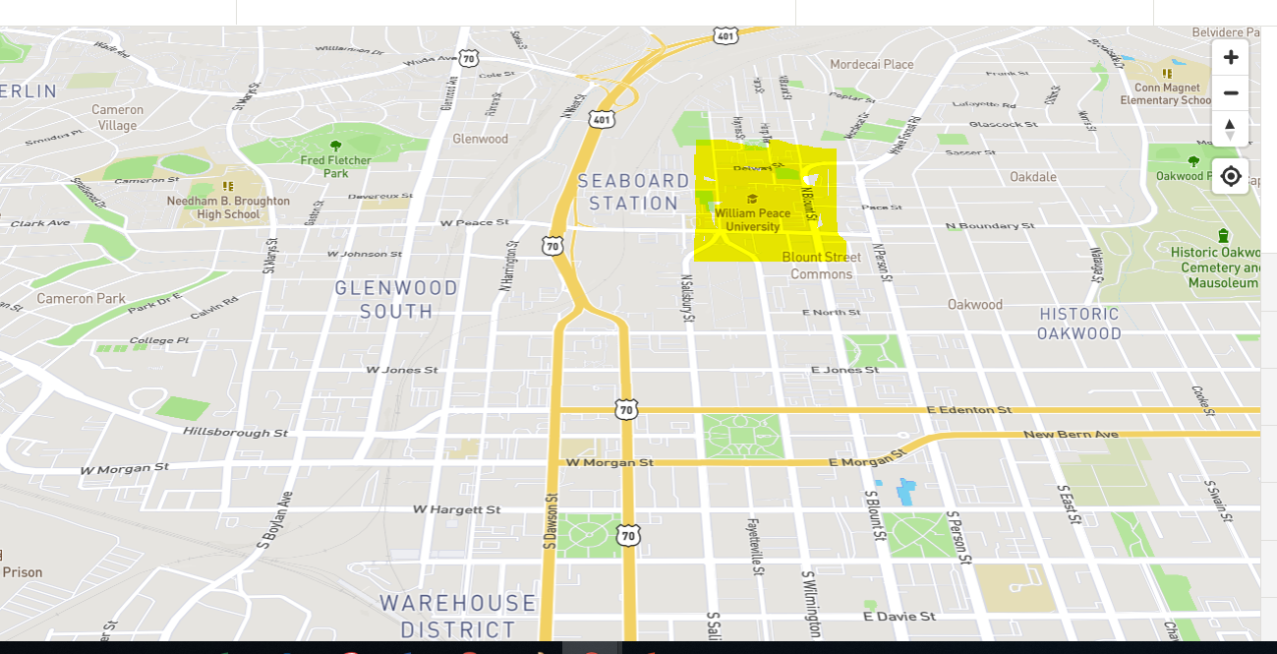
Maps of Downtown Area

