Slide 1
Recommendations for First-Generation College Students
New Student Orientation

Slide 2

Recommendations for First-Generation College Students
Attend and Actively Engage in Orientation and Pathways
Top Ten Things You Need to Know about the Center for Student Success (CSS)
Notes:
You are off to a great start!!!

Slide 3

Recommendations for First-Generation College Students
Know your instructors and make sure they know you!
Top Ten Things You Need to Know about the Center for Student Success (CSS)
Notes:
During the first 3 weeks of classes go to each of your instructors during office hours to introduce yourself and ask them what tips and advice do they have for being successful in their class and in college. Tell them your story, including the fact that you are a First -Gen students- a trail blazer!!!

Slide 4

Recommendations for First-Generation College Students
Utilize Campus Resources
Top Ten Things You Need to Know about the Center for Student Success (CSS)
Notes:
Campus resources (tutoring services, counseling, Library, Financial Aid, RAs, ACs, PMs, are a few examples) only work if you use them! Be responsive to offers of help.

Slide 5

Recommendations for First-Generation College Students
Be Proactive: Don’t wait to ask for help!
Don’t be afraid to ask questions
Top Ten Things You Need to Know about the Center for Student Success (CSS)
Notes:
It is OKAY to not know what to do and it is NORMAL to feel overwhelmed. Find a mentor/person you connect with to share that you are overwhelmed or lost. It is a sign of strength and GRIT to ask for help in a brand new situation! We don’t want you to do this alone! Asking questions shows you are interested and committed! FYS 100 is a great place to feel safe to ask any questions.

Slide 6

Recommendations for First-Generation College Students
Get involved!
Top Ten Things You Need to Know about the Center for Student Success (CSS)
Notes:
Pay attention to all that is offered and attend events, programs, plays, sporting events, club/org meetings, etc.

Slide 7
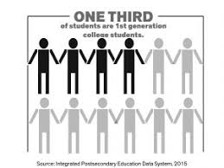

Recommendations for First-Generation College Students
Develop Mentor Relationships and Support Systems
Top Ten Things You Need to Know about the Center for Student Success (CSS)
Notes:
WE give you 2 mentors to start- FY Mentor and PM BUT be actively looking for people that you connect with and that inspire you!

Slide 8

Recommendations for First-Generation College Students
Find and Maintain Balance
Top Ten Things You Need to Know about the Center for Student Success (CSS)
Notes:
while in college you will have a lot to juggle! Balance, organization, and time management will be key to your success. With your academic, social, work, and family responsibilities, it will be important for you to find a way to balance competing needs and obligations. Remember the hard work that got you here will also help keep you here.

Slide 9

Recommendations for First-Generation College Students
Ask For the Support of Your Parents/Family
Top Ten Things You Need to Know about the Center for Student Success (CSS)
Notes:
since your parents did not pursue a bachelor’s degree, they may not understand what you are experiencing and the amount of time and effort you will be putting into your academics. Provide your family members with an idea of what college is like by sharing with them your daily activities and let them know how they can best support you!

Slide 10
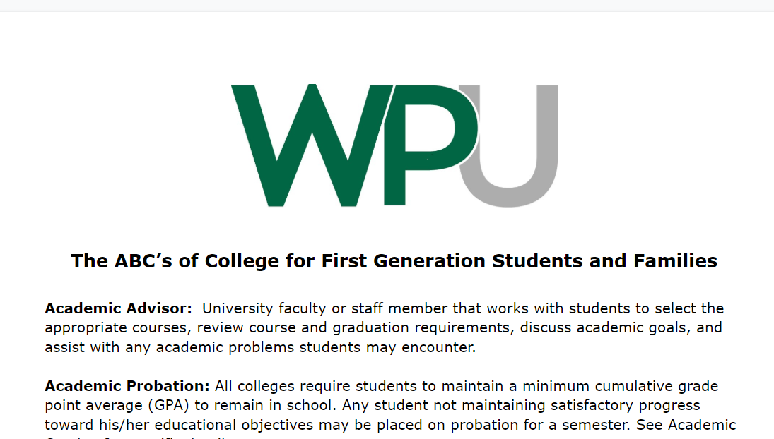
Recommendations for First-Generation College Students
Make sure to check out the ABCs of College on Moodle
(under the Additional Info and Resources Section)
Top Ten Things You Need to Know about the Center for Student Success (CSS)
Notes:
It is a document that define most terms used when starting college!

Slide 11

Recommendations for First-Generation College Students
Q & A Time!
Or email us at CSS@Peace.Edu
Ma
Top Ten Things You Need to Know about the Center for Student Success (CSS)

