Slide 1

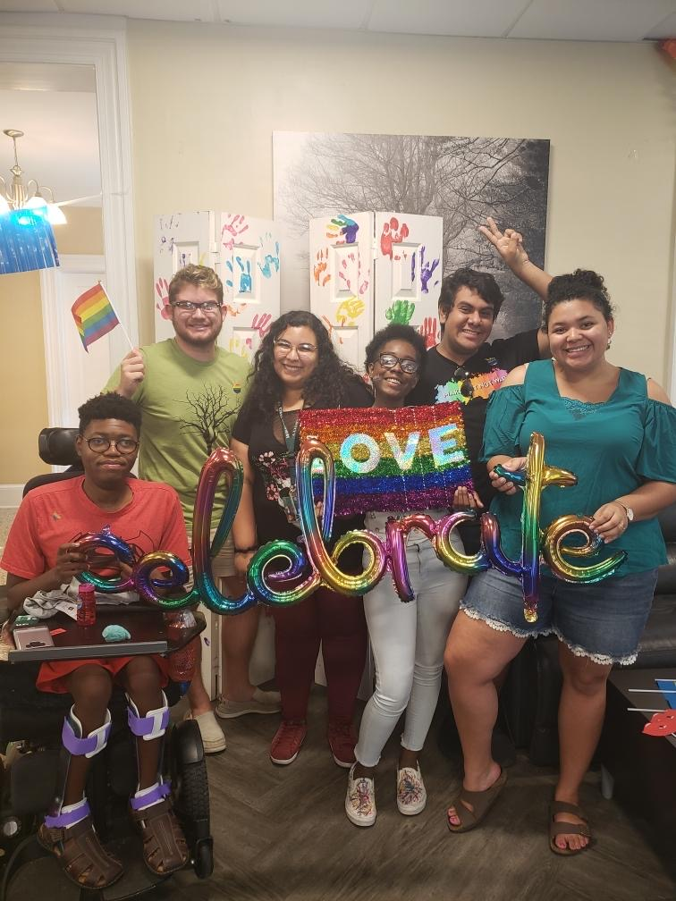

Engaging Your Voice to Build CommUnity
Notes:
Hello Everyone! Welcome, from the WPU Office of Diversity & Inclusion.
I am Stephanie Reed, the office Director and I am pleased to spend time presenting you with a brief overview of the diversity office.
As you learn more about the office, I want you to think of this as the beginning ENGAGING YOUR VOICE on campus to BUILD CAMPUS COMMUNITY.

Slide 2
Mission & Purpose of Diversity & Inclusion @WPU
WPU Office of Diversity & Inclusion provides SUPPORT, ADVOCACY, TRAINING & EDUCATION and COMMUNITY building events and programs.
WHY is this a resource?
This office is a direct link to our university values:
Diversity, Inclusion & Respect and Commitment to Community
Notes:
The office of diversity & inclusion has a specific mission and vision. Each of you received a handout in your orientation materials –there you can find the mission and vision for your review.
Let me summarize for you here the purpose and function of this office.
The programs, services this office provides to the campus community can be organized into THREE CATEGORIES:
Support & Advocacy---Training & Education----and Community Building
This office was developed as a resource for this campus as a direct result of two of the university’s core values. ONE—our Diversity, Inclusion & Respect value and TWO our Commitment to Community.
The office provides leadership for the campus community to live up to those values.

Slide 3

Programs & Services= Engaging our Diversity
Notes:
HOW DO WE DO THAT?
Through an intentional set of programs and services
With these programs and services we ENGAGE the diversity on our campus.
I’m gonna explain that more here by focusing on this collage of images in this slide.
But first, let me broadly define diversity. When we speak about diversity at WPU we are referring to the many characteristics and identities of our community, more specifically our students. For instance we mean race, nationality, gender, religion, veteran status, ability, sexual orientations, varied philosophies and perspectives, socio-economic levels, cultural differences and more.
All of this diversity exists within our campus community. What makes our campus inclusive is the act of engaging all of those differences. Because diversity is who we are, while inclusion is our intentional acts of engaging all the parts of who we are.
For instance, this collage represents only a small portion of the programs and services engaging our varied campus interests.

Slide 4

RESPECT Leads to INCLUSION
Respect is part of one of the university’s core values; thus it is at the core of our expectations for campus community members
RESPECT one another’s strengths, privacy, space, contributions, limitations, knowledge, identities, opinions & perspectives, right to learn, etc.
Notes:
The other part of the institutional vale is RESPECT. This also leads us to GREATER Inclusion.
You may not remember much of the terminology I've used so far to describe the office, but THIS is a simple yet key takeaway from this session.
RESPECT is at minimum a core value and an expectation for every campus community member. If WE LEAD WITH RESPECT this LEADS TO INCLUSION.
This office and others will describe for you what RESPECT as part of WPU community translates to. The diversity office expects, teaches and models respecting one another's strengths, opinions, abilities, privacy and space, respect of ppls contributions and limitations, respect each others cultures and backgrounds and much more.
These acts of respect make an inclusive campus community.

Slide 5

Addressing Barriers to INCLUSION
We have a Bias Incident Reporting Process
This process is managed and supported by a team of various staff and faculty members
This team is known as B.E.S.T.
  The BIAS EDUCATION & SUPPORT TEAM
You will learn more about this team and process in the coming weeks and throughout your 1st year.
Notes:
We also understand that campus life will not always be ideal. In fact we recognize that as students you may experience moments where respect is overshadowed by things such as assumptions, pre-conceived notions or even moments of exclusion.
When these occurrences become barriers to campus inclusion, or barriers to students’ success, we have ways to address this.
Students can use our bias reporting process. We have an easy way for students to let someone know about bias they experience or witness.
We also have a team of faculty & staff dedicated to managing this process. This team is know as BEST---
The BIAS EDUCATION & SUPPORT TEAM.
You will learn more about this team and be introduced to them when you begin the fall semester.

Slide 6
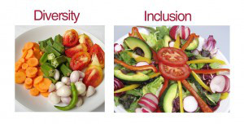
What Does All this Mean?
Our campus is enhanced by its diversity; it is made even better, more vibrant and enjoyable when it is inclusive!
Notes:
Pictured here is a plate of veggies to represent our diversity.
Also pictured here is a salad—the salad is comprised of what----veggies.
Now some would say the salad has more appeal, more to offer due to the variety of flavors experienced when consuming the veggies as a salad. When consuming the veggies as a salad you are still consuming each veggie, sometimes all together, sometimes smaller bites of just a few. (also known as engaging in diversity or being inclusive)
AND, it could be said that the flavors of each veggie that makes up this salad are enhanced by the others.
How does this translate to our campus story?
Well, our campus is diverse. Our campus is ENHANCED by its diversity. It is made EVEN BETTER, more vibrant and enjoyable when it is inclusive.

Slide 7
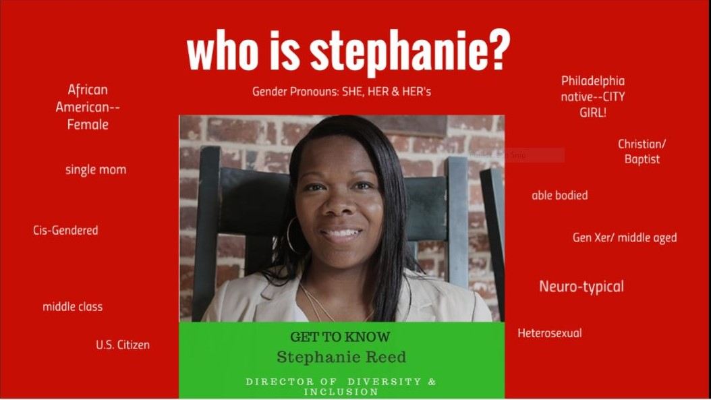
Notes:
Enough about veggies and salad, vision and mission……let’s get to the stuff I really hope you remember.
When you join us on campus in the fall there will be plenty of time for you to learn much more about the specifics.
To me, its also important you to know who I am. And when you meet me in person, you will hear me introduce myself with certain descriptions called social identities.
So remember, Ms Stephanie Reed, is the Director of the Office of Diversity & Inclusion. My pronouns are SHE, HER & HERS.
I am also a native of Philadelphia, PA, I am an African American –Cisgender female and a mother of three. These are just a few of my social identities.
You will also be learning about, introduced to, exploring further and gaining more insight into a litany of other social identity groups and lived experiences.
My role on campus is to engage all of them fro us as a community.

Slide 8

Thanks for Listening!
I look forward to answering your questions in our online Q&A session soon!

